Slide 1




Slide 2
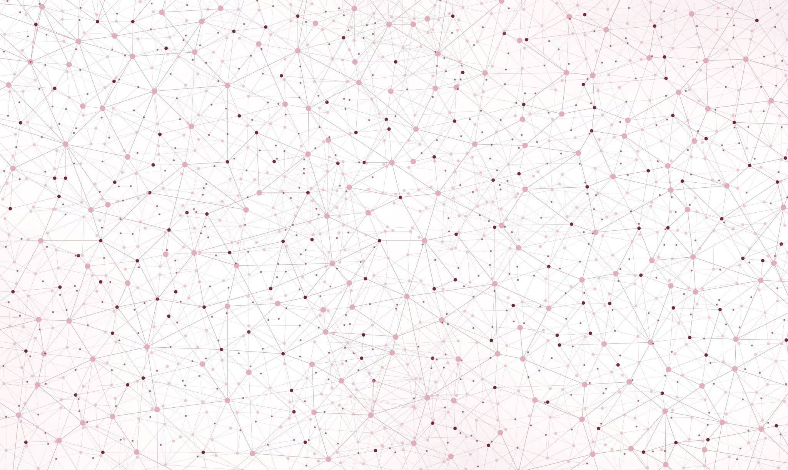
Cell Nuclei Segmentation
Implementation and Evaluation
of Otsu Thresholding
Project Proposal
Topic 01: Biomedical Image Analysis
Supervisor: PD Dr. Karl Rohr, Christian Ritter, Tutor: Marie Becker
Group 01.04: Marie-Claire Indilewitsch, Helen Jade, Maribel Schneider, Ieva Sorokina-Ozola
Date: 18.05.2022

Slide 3
Overview
Data
Challenges and Ideas
Project management
Procedure

Slide 4
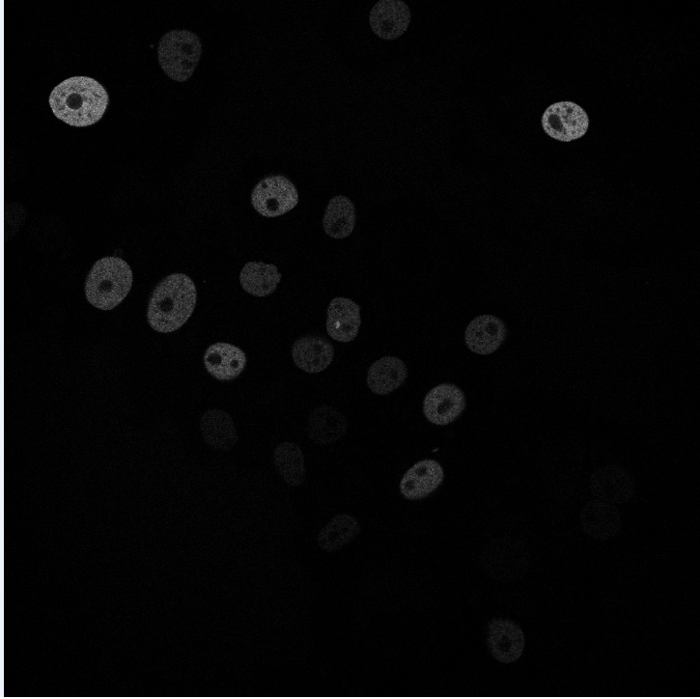
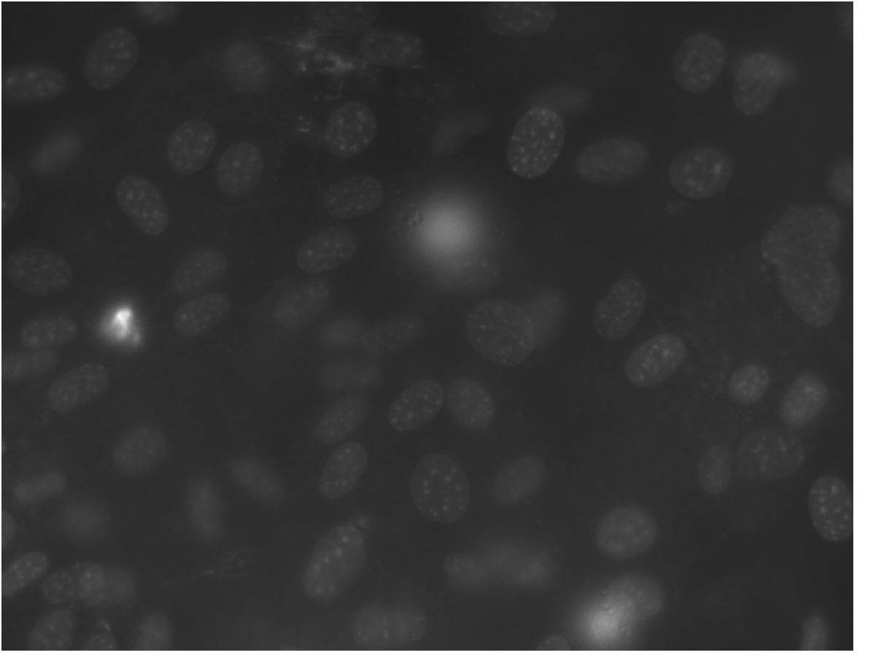
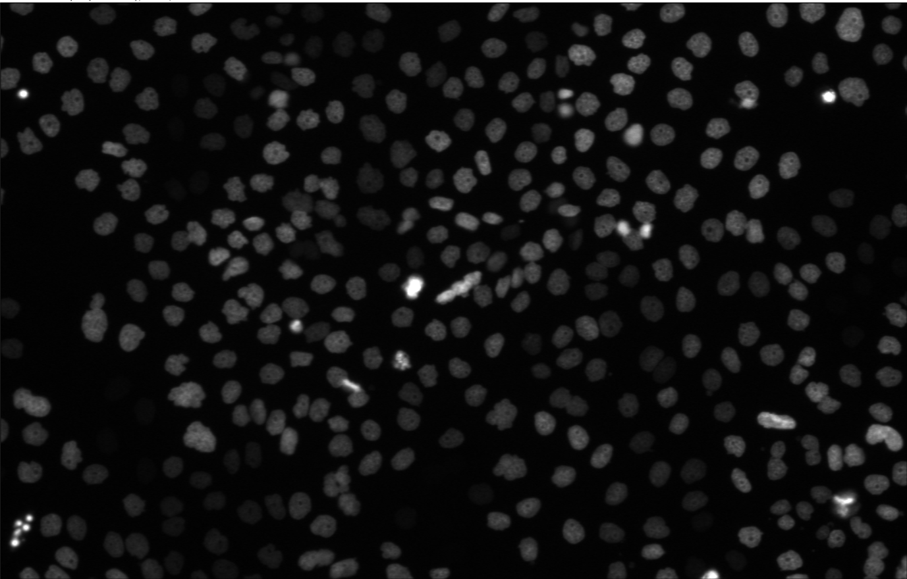


N2DL-HeLa (third dataset)
N2DH-GOWT1 (first dataset)
NIH3T3
(second dataset)
Organism: mouse (Mus musculus)
Cell type: embryonic stem cells
Staining: Oct4-GFP
Organism: mouse (Mus musculus)
Cell type: embryonic fibroblast cells
Staining: Hoechst
Organism: human (Homo sapiens)
Cell type: cervical adenocarcinoma cells
Staining: H2b-GFP
L: low resolution
N: nuclear
H: high resolution
2D: two-dimensional

Slide 5
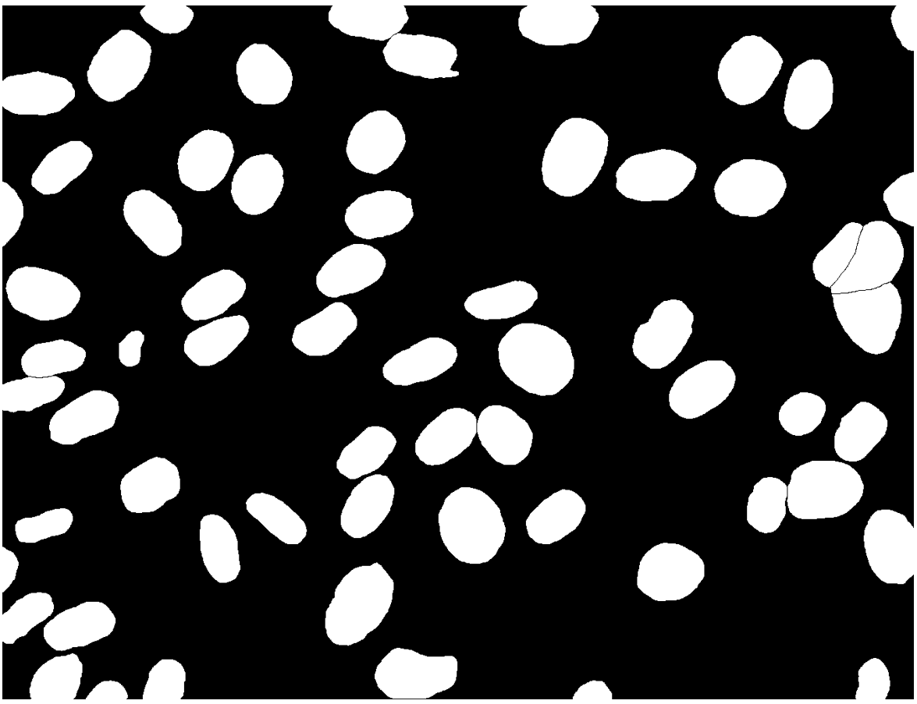
Image types
Image
Ground Truth

Slide 6



Procedure
Input image
Preprocessing
Otsu Thresholding
Dice Score

Slide 7
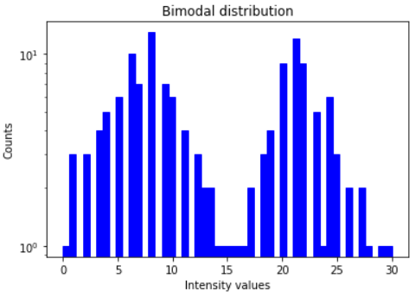
Otsu Thresholding
Automatic threshold selection for picture segmentation

Slide 8
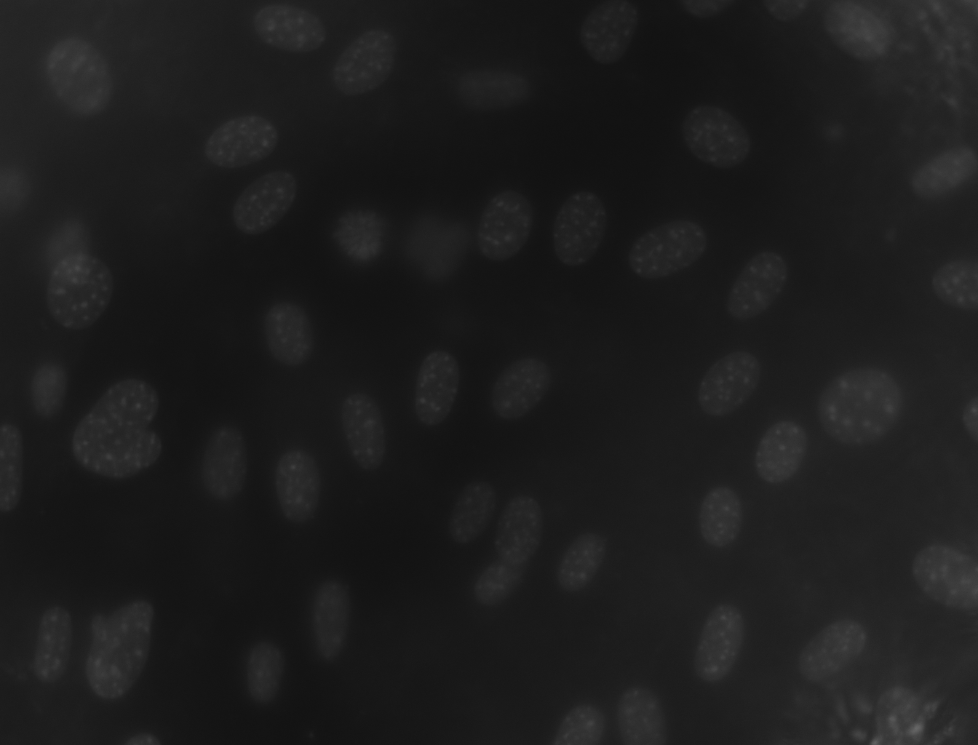
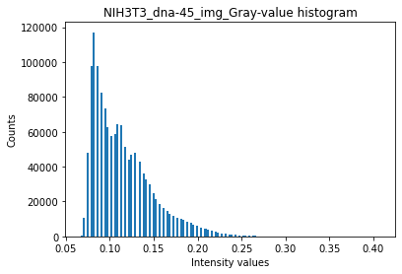
Otsu Thresholding

Slide 9


Otsu Thresholding
Determintation of the optimal threshold value by maximizing the between-class variance or equivalently minimizing the the within-class variance
Between-class variance
$σ_{B}^{2}=ω_{0}ω_{1}\left(μ_{1}−μ_{0}\right)$²
$ω_{0,1}$ = Probabilities of class occurrence
$μ_{0,1}$ = Class mean levels
Within-class variance
$$σ_{W}^{2}=ω_{0}σ_{0}^{2}+ω_{1}σ_{1}^{2}$$
$ω_{0,1}$ = Probabilities of class occurrence
$σ_{0,1}^{2}$= Class variances

Slide 10
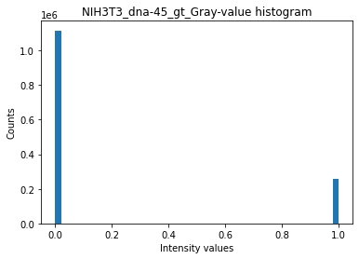
Otsu Thresholding
$$I_{seg}\left(x,y\right)=\left\{\begin{aligned}0 if I\left(x,y\right)≤T \\ 1 if I\left(x,y\right)>T\end{aligned}\right.$$
𝐼_𝑠𝑒𝑔 (𝑥,𝑦)={█(0 𝑖𝑓 𝐼(𝑥,𝑦)≤𝑇@1 𝑖𝑓 𝐼(𝑥,𝑦)>𝑇)┤

Slide 11



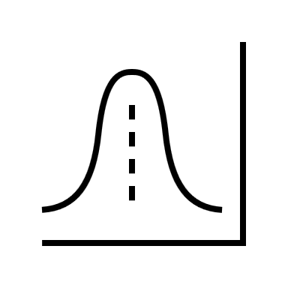
Otsu Thresholding - Algorithm
Input image
Histogram
Set up initial $ω_{i}\left(0\right)$ and $μ_{i}\left(0\right)$
Set up initial 𝜔_𝑖 (0) and 𝜇_𝑖 (0)
Update values of $ω_{i}$(T) and $μ_{i}$(T)
Update values of 𝜔_𝑖(T) and 𝜇_𝑖(T)
Compute variances $σ_{B}^{2}$ and $σ_{W}^{2}$
Compute variances 𝜎_𝐵^2 and 𝜎_𝑊^2
Select threshold intensity T
Image clipping
Output image

Slide 12


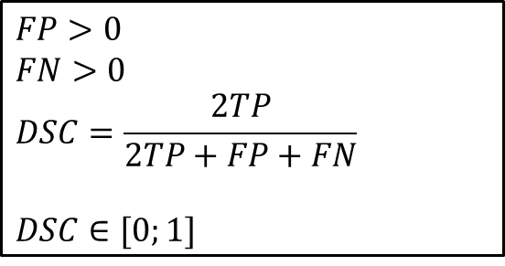
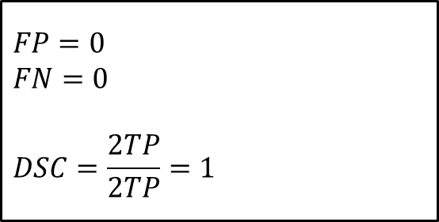
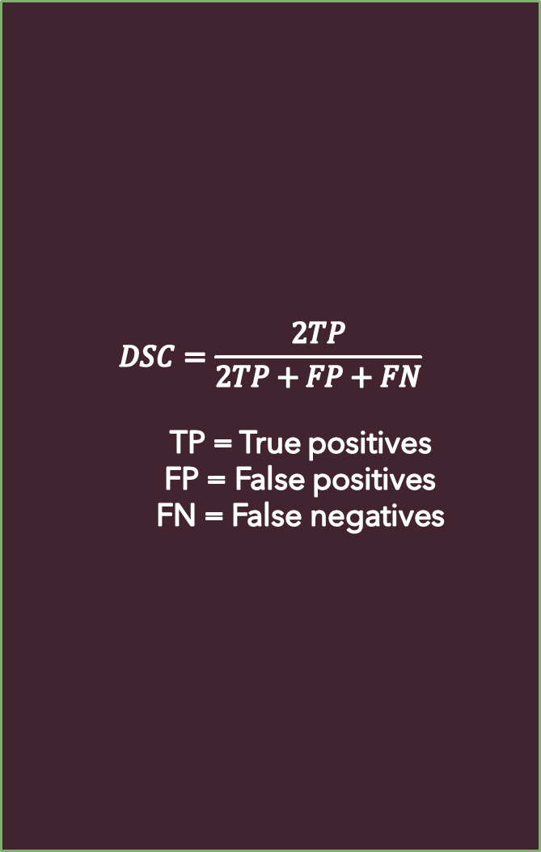
Dice Score
$$DSC=\frac{2TP}{2TP+FP+FN}$$
TP = True positives
FP = False positives
FN = False negatives
Post Otsu = Ground truth
$$FP=0$$
$$FN=0$$
$$DSC=\frac{2TP}{2TP}=1$$
TP
Ground truth
$$FP>0$$
$$FN>0$$
$$DSC=\frac{2TP}{2TP+FP+FN}$$
$$DSC∈[0;1]$$
FN
TP
FP
Post Otsu

Slide 13



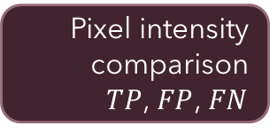
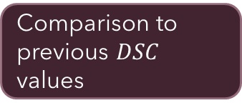
Dice score - Implementation
Iteration over gt and tresholded pictures
Algorithm optimisation
Pixel intensity comparison
$TP$, $FP$, $FN$
Comparison to previous $DSC$ values
$DSC$ computing
and storing

Slide 14

Challenges: N2DH-GOWT1
Noise
Low contrast
Holes
https://threshold.imageonline.co/

Slide 15
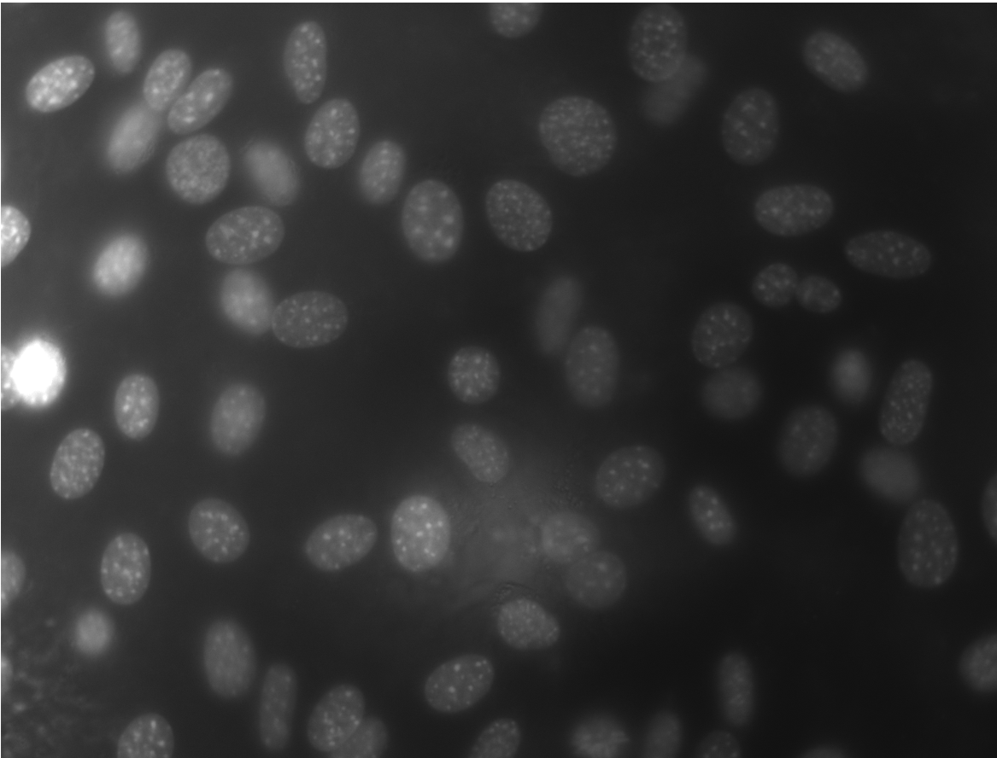
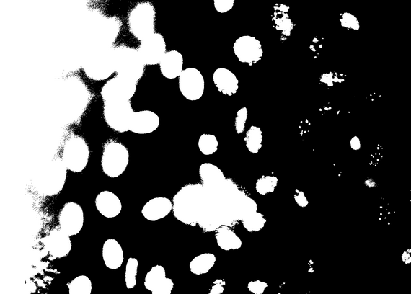
Challenges: NIH3T3
Brightness
Reflection
https://threshold.imageonline.co/

Slide 16
Solution Ideas
Challenge | Solution
Random noise | Gaussian filter, median filter
Holes | Median filter
Low contrast | Histogram stretching
Reflections | Intensity clipping, multithresholding
Brightness | Local thresholding

Slide 17
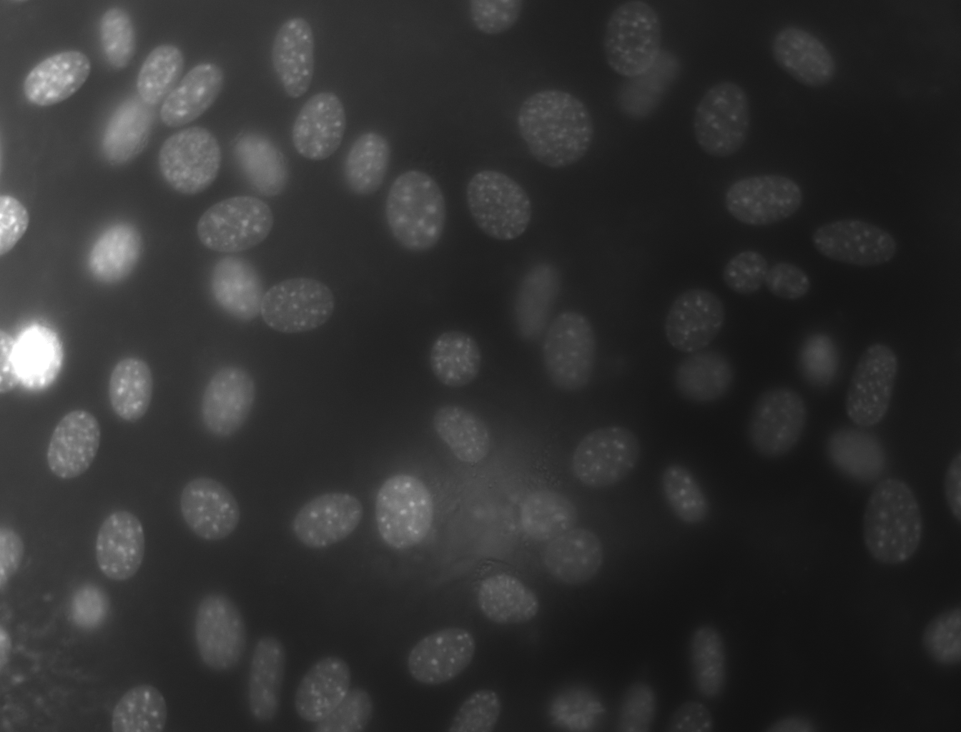
Local Thresholding - Sliding window scheme

Slide 18


Timeline
First steps
Final presentation
Local threshold
Otsu and Dice
10.05.
31.05.
14.06.
Buffer and report
28.06.
21.06.
17.05.
07.06.
Cell counting
Multithresholding
Project proposal
Preprocessing and testing

Slide 19
Milestones and Deliverables
First steps
Plan and organize team
Read resources and understand data
Project proposal
Visualize data and understand algorithms
Otsu and Dice
Implement Otsu thresholding and dice score
Finish project proposal

Slide 20

Preprocessing and testing
Implement different preprocessing features
Test pipeline on optimized images
Local threshold
Implement sliding window scheme
Multithresholding
Implement multithresholding
Cell counting
Implement cell counting algorithm
Final weeks:
Finished report
Cleaned up GitHub
Collab with other group

Slide 21
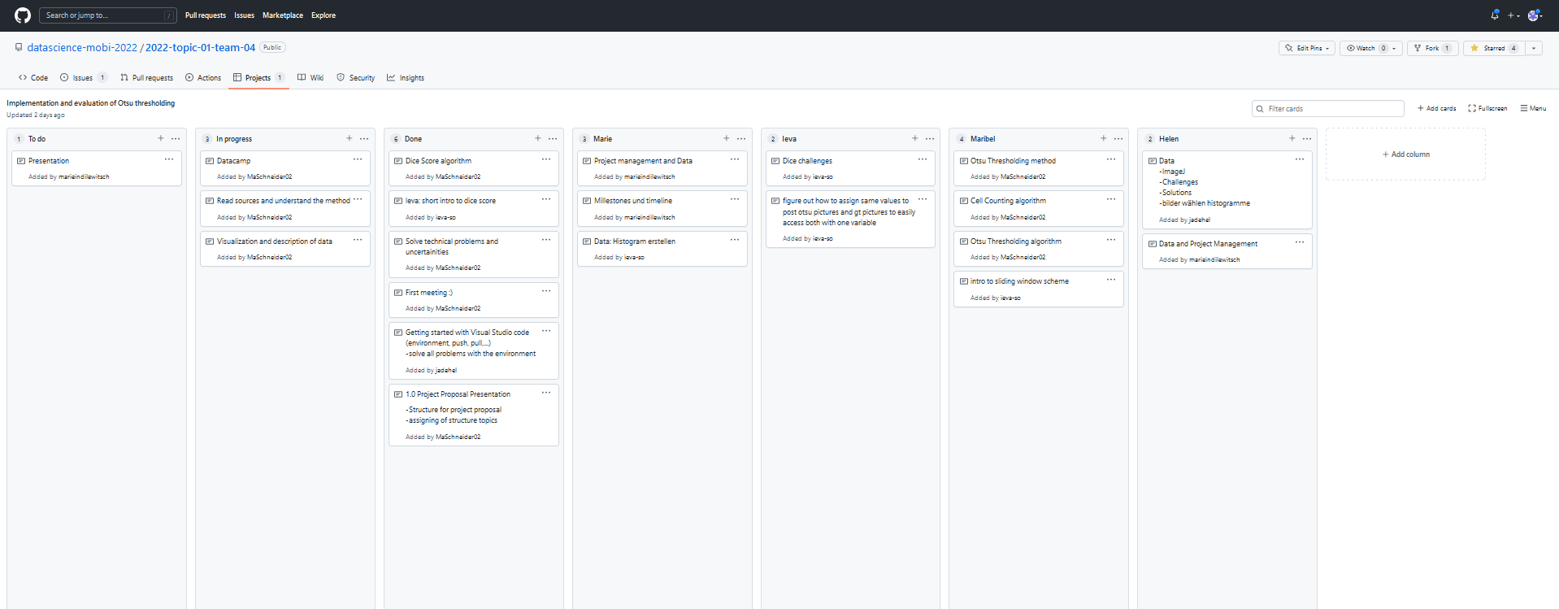
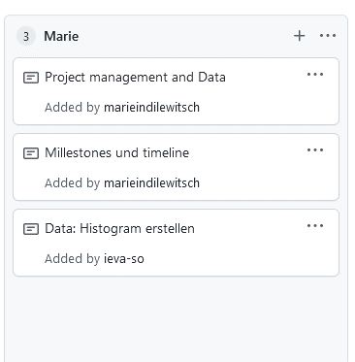



Team
Meetings
Teamwork
GitHub
2-3x a week
Live and online
Use project feature
Repository
Work in pairs
Help each other

Slide 22
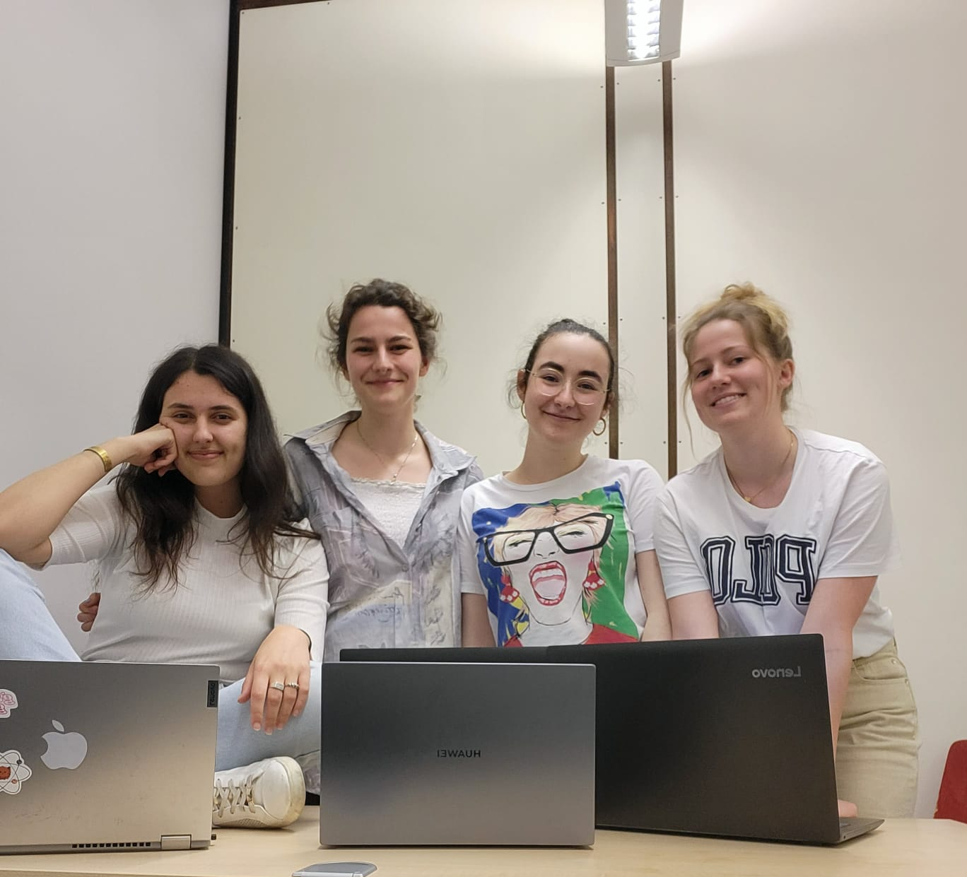
Thank you for your attention!

Slide 23

Extra slides

Slide 24
Challenges: N2DL-HeLa
Reflections

Slide 25
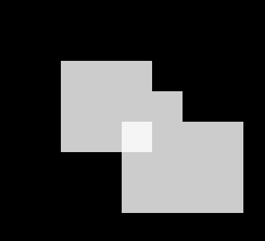


Dice score - Issues

Slide 26
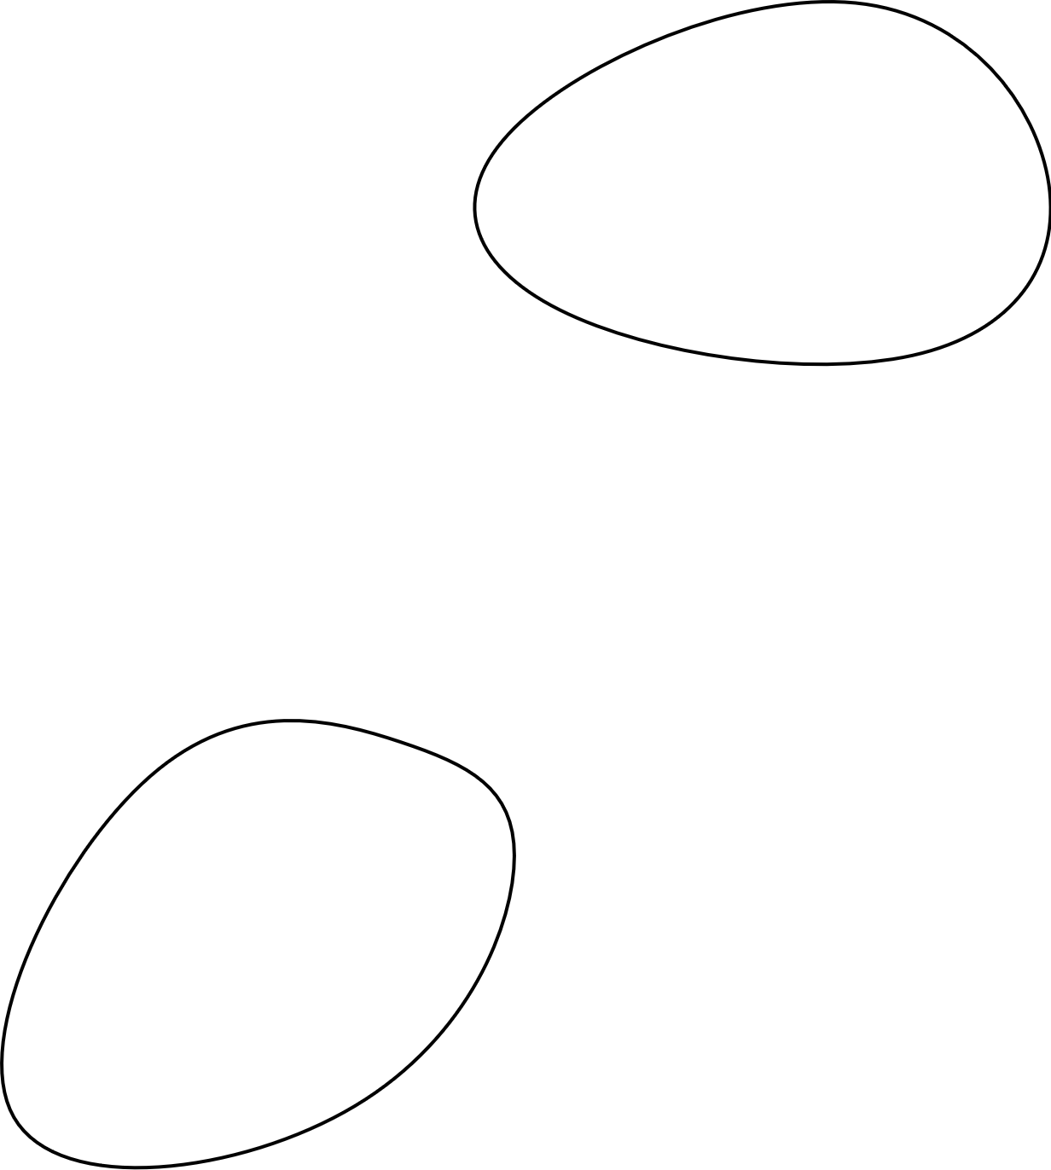
Evaluation algorithm – Dice score
~ 80% Accuracy

Slide 27

N2DH-GOWT1 Cell type: embryonic stem cells | Organism: Mouse (Mus musculus)
Express Oct4-GFP
Leica TGS SP5 (confocal microscope)
6 images total
1024x1024 pixels
10-20 nulei per image

Slide 28
NIH3T3 Cell type: Embryonic fibroblast cells | Organism: Mouse (Mus musculus)
Stained with Hoechst (fluorescent dye)
Fluorescence microscope
18 images total
Size: 1344x1024 pixels
about 60 nuclei per image

Slide 29

N2DL-HeLa Cell type: cervical adenocarcinoma cells | organism: human (Homo sapiens)
Express H2B-GFP
Olympus IX81 Confocal Microscope
4 images total
Size: 1100x 700 pixels
30-50 nuclei per image

Slide 30
Otus Thresholding usage
Locate cell boundaries
Cell type classification
Cell counting
Cell phenotype analysis (size, shape,..)
But not used for very complex images !

Slide 31
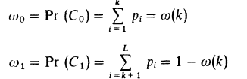
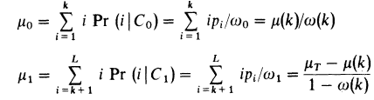
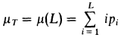
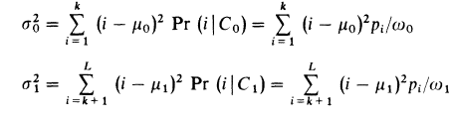
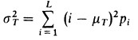
Otsu Thresholding
Class probabilities ($ω_{0,1}$):
Class mean levels ($μ_{0,1}$) and total mean level ($μ_{T}$):
Class variances ($σ_{0,1}^{2}$) and total variance ($σ_{T}^{2}$):
$L=$ Number of gray levels in the picture
$n_{i}=$ Number of pixels at level i
$N=$ Total number of pixels
$p_{i}=$ Probability of level i
$k=$ Threshold intensity
$$p_{i}= n_{i}/N$$
Otsu, N. "A threshold selection method from gray-level histograms." IEEE Transactions on Systems, Man, and Cybernetics 9:1 (1979), pp 62-66.

Slide 32
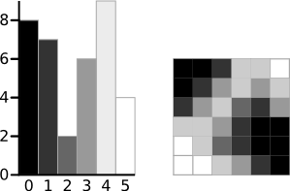
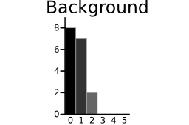
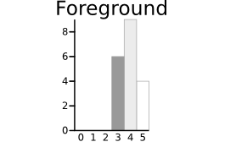
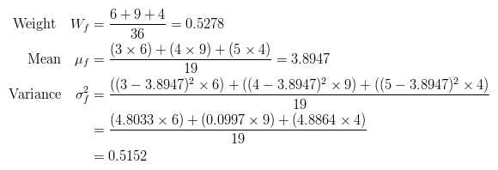
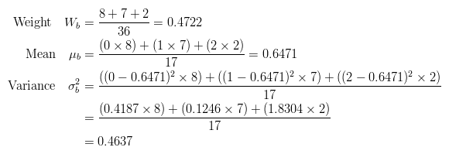
Otsu Thresholding
http://www.labbookpages.co.uk/software/imgProc/otsuThreshold.html

Slide 33
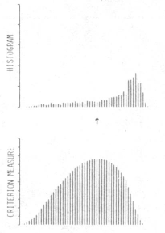
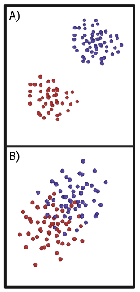

Discriminant Criterion Measure
Criterion measure
$η\left(T\right)=σ_{B}^{2}\left(T\right)/$ $σ_{T}^{2}$
$σ_{B}^{2}$= Between-class variance
$σ_{T}^{2}$ = Total variance
$0≤η^{∗}≤1$
Otsu, N. "A threshold selection method from gray-level histograms." IEEE Transactions on Systems, Man, and Cybernetics 9:1 (1979), pp 62-66.

Slide 34
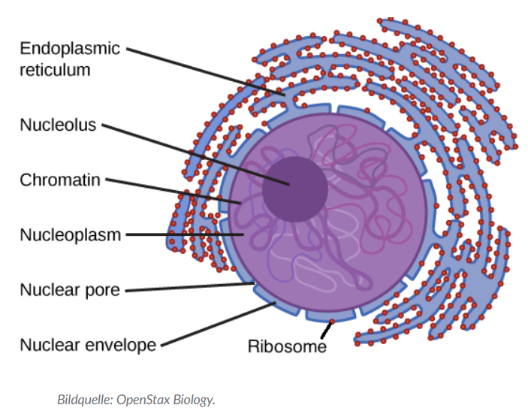
Holes

Slide 35
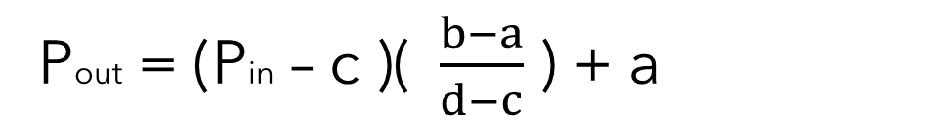
Histogram stretching
stretching range of intensity values to achieve a higher contrast -> linear scaling
Pout = (Pin – c )($\frac{b−a}{d−c}$ ) + a
https://homepages.inf.ed.ac.uk/rbf/HIPR2/stretch.htm

Slide 36
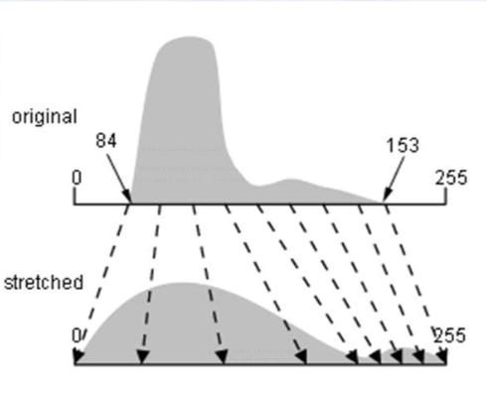
Example Histogram stretching
https://i.stack.imgur.com/9gIw6.png

Slide 37
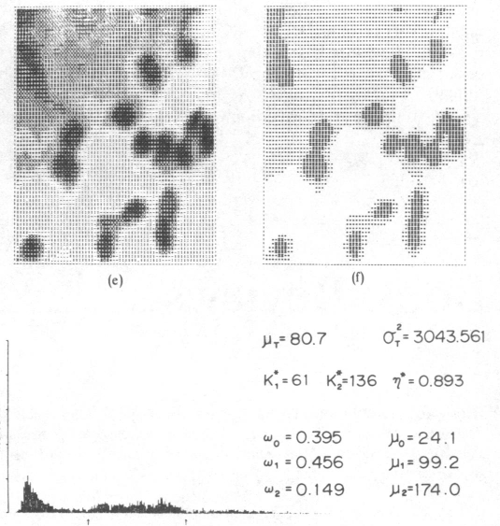

Two-level Otsu Thresholding
Two-level Otsu Thresholding
$σ_{B}^{2}=ω_{1}\left(μ_{1}−μ_{T}\right)2−$ $ω_{2}\left(μ_{2}−μ_{T}\right)2−$ $ω_{3}\left(μ_{3}−μ_{T}\right)2$
$ω_{1,2,3}$ = Probabilities of class occurrence
$μ_{1,2,3}$ = Class mean levels
$μ_{T}$ = Total mean level
Otsu, N. "A threshold selection method from gray-level histograms." IEEE Transactions on Systems, Man, and Cybernetics 9:1 (1979), pp 62-66.

Slide 38
Application of Filter
Choose Filtermask
Convolution
Flipping filter
Multiplication of filter values with image intensity values
Summation of the multiplication results

Slide 39
Cell counting
Why?
Monitor health of the cells
Proliferation rate
How?
Edge detection

Slide 40
Other threshold methods | Other segmentation methods
Kittler´s thresholding | K-means
Kapur´s thresholding | Watershed
Tsai´s thresholding | Graph cuts

